Slide 1
Direct modular exponentiation is only practical for small values
INSERT
VIDEO
HERE

Slide 2

Direct modular exponentiation is only practical for small values
$$x≡3^{5}\left(mod 143\right)$$
INSERT
VIDEO
HERE

Slide 3
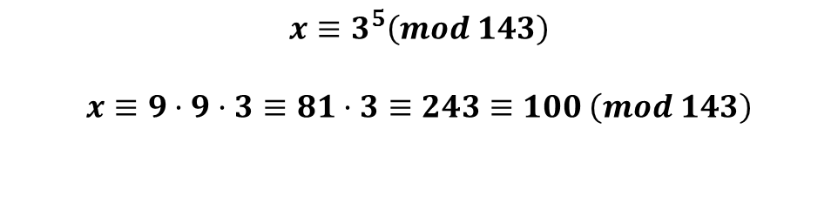
Direct modular exponentiation is only practical for small values
$$x≡3^{5}\left(mod 143\right)$$
$$x≡9·9·3≡81·3≡243≡100 \left(mod 143\right)$$
INSERT
VIDEO
HERE

Slide 4
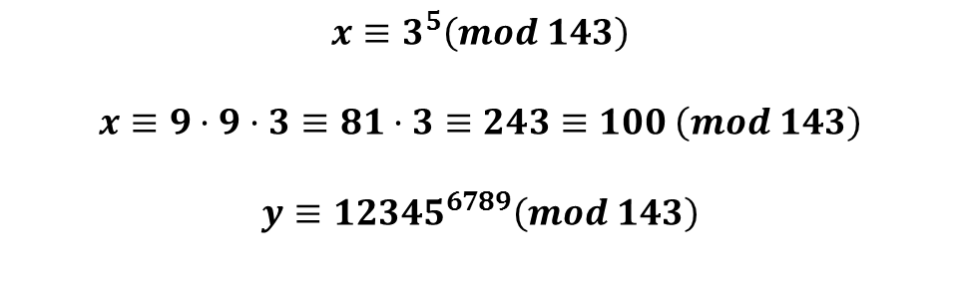
Direct modular exponentiation is only practical for small values
$$x≡3^{5}\left(mod 143\right)$$
$$x≡9·9·3≡81·3≡243≡100 \left(mod 143\right)$$
$$y≡{12345}^{6789}\left(mod 143\right)$$
INSERT
VIDEO
HERE

Slide 5
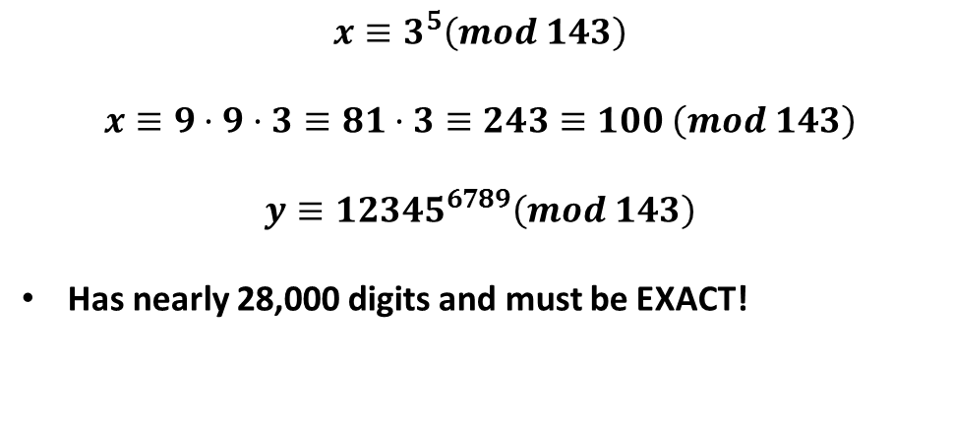
Direct modular exponentiation is only practical for small values
$$x≡3^{5}\left(mod 143\right)$$
$$x≡9·9·3≡81·3≡243≡100 \left(mod 143\right)$$
$$y≡{12345}^{6789}\left(mod 143\right)$$
Has nearly 28,000 digits and must be EXACT!
INSERT
VIDEO
HERE

Slide 6
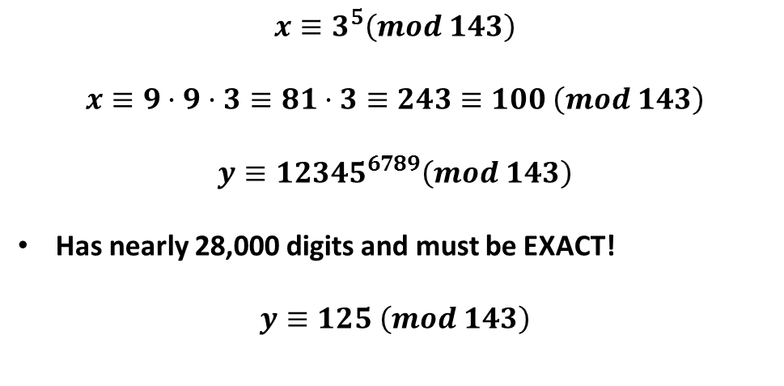
Direct modular exponentiation is only practical for small values
$$x≡3^{5}\left(mod 143\right)$$
$$x≡9·9·3≡81·3≡243≡100 \left(mod 143\right)$$
$$y≡{12345}^{6789}\left(mod 143\right)$$
Has nearly 28,000 digits and must be EXACT!
$$y≡125 \left(mod 143\right)$$
INSERT
VIDEO
HERE

Slide 7
Reducing operands helps (some)
INSERT
VIDEO
HERE

Slide 8

Reducing operands helps (some)
$${12345}^{6789}≡{47}^{6789}(mod 143)$$
INSERT
VIDEO
HERE

Slide 9
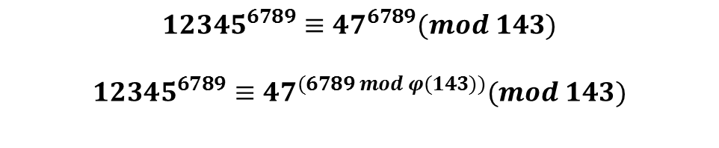
Reducing operands helps (some)
$${12345}^{6789}≡{47}^{6789}(mod 143)$$
$${12345}^{6789}≡{47}^{(6789 mod φ(143))}(mod 143)$$
INSERT
VIDEO
HERE

Slide 10
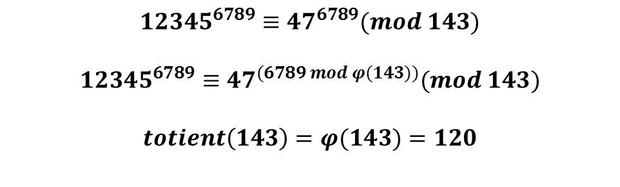
Reducing operands helps (some)
$${12345}^{6789}≡{47}^{6789}(mod 143)$$
$${12345}^{6789}≡{47}^{(6789 mod φ(143))}(mod 143)$$
$$totient\left(143\right)=φ(143)=120$$
INSERT
VIDEO
HERE

Slide 11
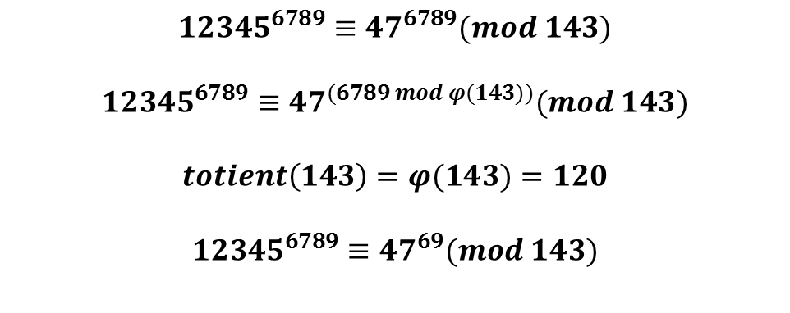
Reducing operands helps (some)
$${12345}^{6789}≡{47}^{6789}(mod 143)$$
$${12345}^{6789}≡{47}^{(6789 mod φ(143))}(mod 143)$$
$$totient\left(143\right)=φ(143)=120$$
$${12345}^{6789}≡{47}^{69}(mod 143)$$
INSERT
VIDEO
HERE

Slide 12
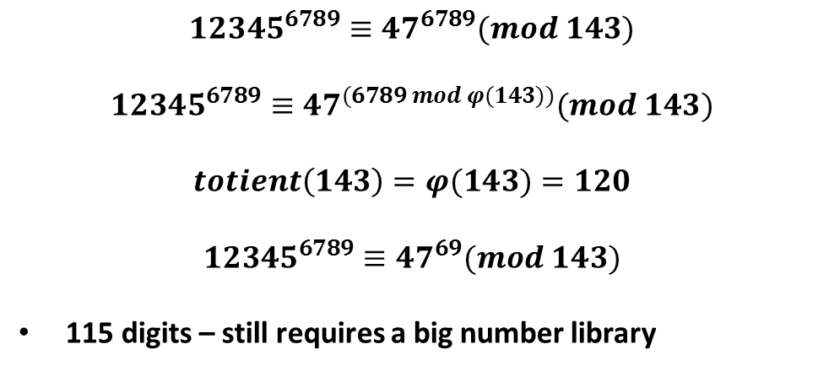
Reducing operands helps (some)
$${12345}^{6789}≡{47}^{6789}(mod 143)$$
$${12345}^{6789}≡{47}^{(6789 mod φ(143))}(mod 143)$$
$$totient\left(143\right)=φ(143)=120$$
$${12345}^{6789}≡{47}^{69}(mod 143)$$
115 digits – still requires a big number library
INSERT
VIDEO
HERE

Slide 13
Multiply-and-reduce is O(modulus)
INSERT
VIDEO
HERE

Slide 14
Multiply-and-reduce is O(modulus)
$${47}^{69}≡(47·47)·{47}^{67}(mod 143)$$
INSERT
VIDEO
HERE

Slide 15

Multiply-and-reduce is O(modulus)
$${47}^{69}≡(47·47)·{47}^{67}(mod 143)$$
$${47}^{69}≡(2209 mod 143)·{47}^{67}(mod 143)$$
INSERT
VIDEO
HERE

Slide 16
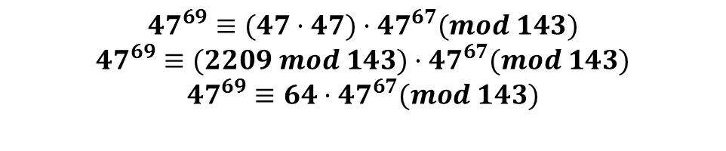
Multiply-and-reduce is O(modulus)
$${47}^{69}≡(47·47)·{47}^{67}(mod 143)$$
$${47}^{69}≡(2209 mod 143)·{47}^{67}(mod 143)$$
$${47}^{69}≡64·{47}^{67}(mod 143)$$
INSERT
VIDEO
HERE

Slide 17
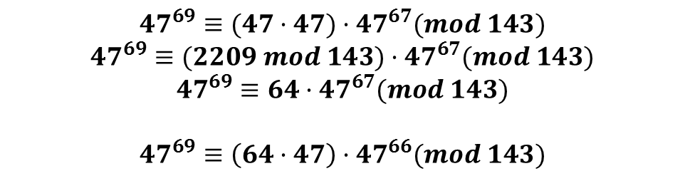
Multiply-and-reduce is O(modulus)
$${47}^{69}≡(47·47)·{47}^{67}(mod 143)$$
$${47}^{69}≡(2209 mod 143)·{47}^{67}(mod 143)$$
$${47}^{69}≡64·{47}^{67}(mod 143)$$
$${47}^{69}≡\left(64·47\right)·{47}^{66}(mod 143)$$
INSERT
VIDEO
HERE

Slide 18
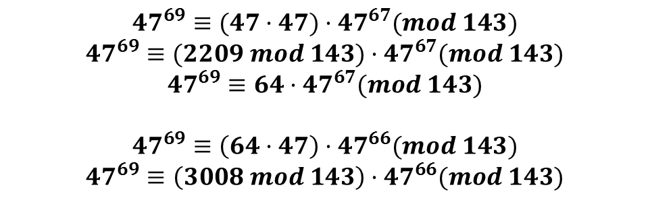
Multiply-and-reduce is O(modulus)
$${47}^{69}≡(47·47)·{47}^{67}(mod 143)$$
$${47}^{69}≡(2209 mod 143)·{47}^{67}(mod 143)$$
$${47}^{69}≡64·{47}^{67}(mod 143)$$
$${47}^{69}≡\left(64·47\right)·{47}^{66}(mod 143)$$
$${47}^{69}≡\left(3008 mod 143\right)·{47}^{66}(mod 143)$$
INSERT
VIDEO
HERE

Slide 19
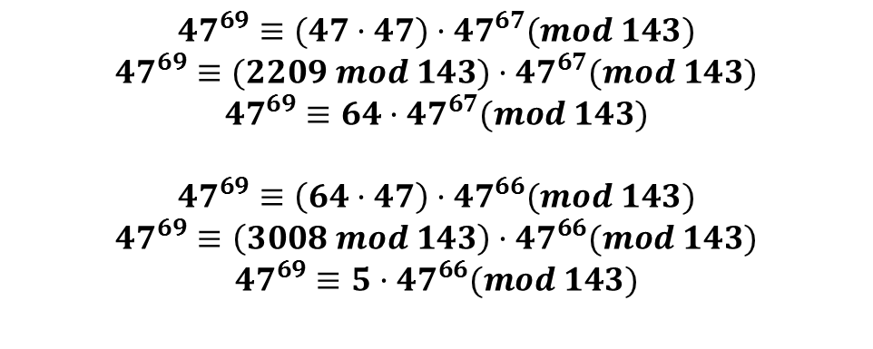
Multiply-and-reduce is O(modulus)
$${47}^{69}≡(47·47)·{47}^{67}(mod 143)$$
$${47}^{69}≡(2209 mod 143)·{47}^{67}(mod 143)$$
$${47}^{69}≡64·{47}^{67}(mod 143)$$
$${47}^{69}≡\left(64·47\right)·{47}^{66}(mod 143)$$
$${47}^{69}≡\left(3008 mod 143\right)·{47}^{66}(mod 143)$$
$${47}^{69}≡5·{47}^{66}(mod 143)$$
INSERT
VIDEO
HERE

Slide 20
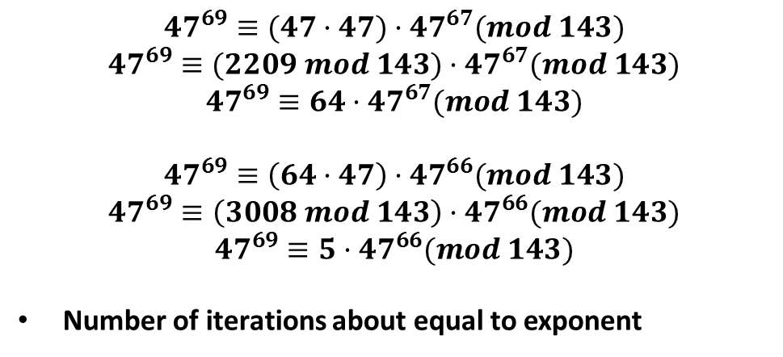
Multiply-and-reduce is O(modulus)
$${47}^{69}≡(47·47)·{47}^{67}(mod 143)$$
$${47}^{69}≡(2209 mod 143)·{47}^{67}(mod 143)$$
$${47}^{69}≡64·{47}^{67}(mod 143)$$
$${47}^{69}≡\left(64·47\right)·{47}^{66}(mod 143)$$
$${47}^{69}≡\left(3008 mod 143\right)·{47}^{66}(mod 143)$$
$${47}^{69}≡5·{47}^{66}(mod 143)$$
Number of iterations about equal to exponent
INSERT
VIDEO
HERE

Slide 21
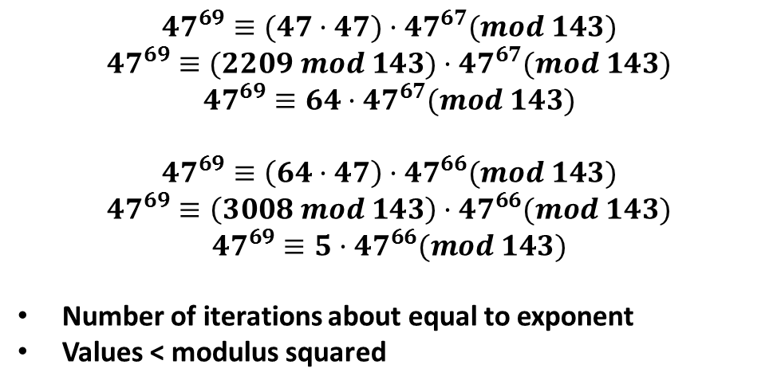
Multiply-and-reduce is O(modulus)
$${47}^{69}≡(47·47)·{47}^{67}(mod 143)$$
$${47}^{69}≡(2209 mod 143)·{47}^{67}(mod 143)$$
$${47}^{69}≡64·{47}^{67}(mod 143)$$
$${47}^{69}≡\left(64·47\right)·{47}^{66}(mod 143)$$
$${47}^{69}≡\left(3008 mod 143\right)·{47}^{66}(mod 143)$$
$${47}^{69}≡5·{47}^{66}(mod 143)$$
Number of iterations about equal to exponent
Values < modulus squared
INSERT
VIDEO
HERE

Slide 22
Square-and-multiply is O(log(modulus))
INSERT
VIDEO
HERE

Slide 23

Square-and-multiply is O(log(modulus))
$${47}^{69}≡{47}^{34}·{47}^{34}·{47}^{1}(mod 143)$$
INSERT
VIDEO
HERE

Slide 24
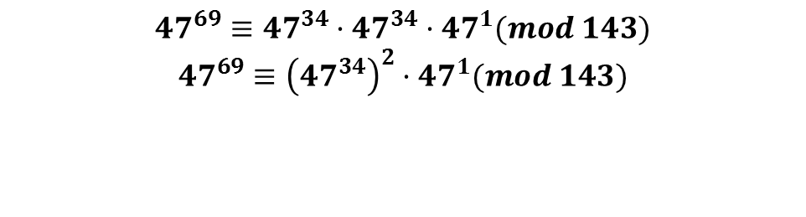
Square-and-multiply is O(log(modulus))
$${47}^{69}≡{47}^{34}·{47}^{34}·{47}^{1}(mod 143)$$
$${47}^{69}≡{\left({47}^{34}\right)}^{2}·{47}^{1}(mod 143)$$
INSERT
VIDEO
HERE

Slide 25
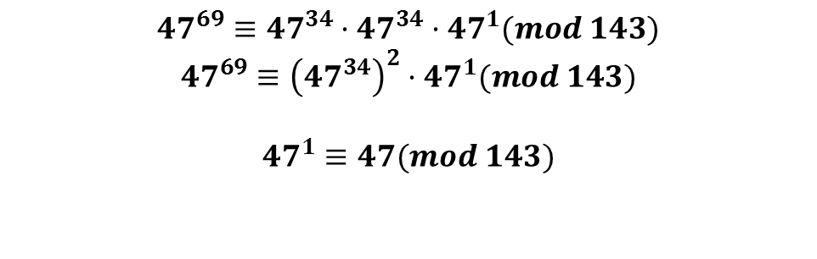
Square-and-multiply is O(log(modulus))
$${47}^{69}≡{47}^{34}·{47}^{34}·{47}^{1}(mod 143)$$
$${47}^{69}≡{\left({47}^{34}\right)}^{2}·{47}^{1}(mod 143)$$
$${47}^{1}≡47(mod 143)$$
INSERT
VIDEO
HERE

Slide 26
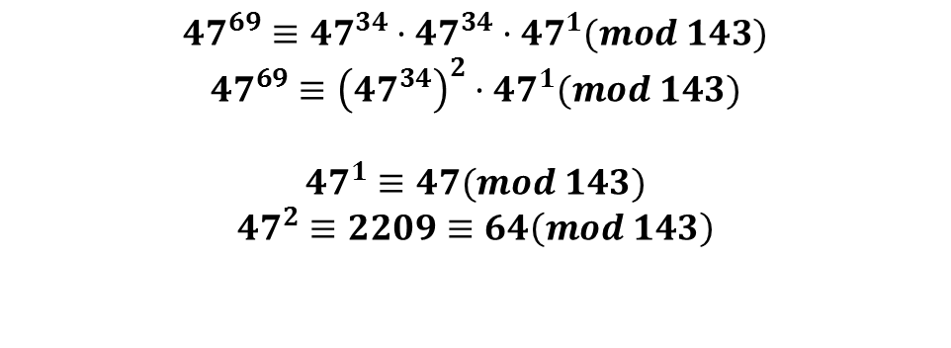
Square-and-multiply is O(log(modulus))
$${47}^{69}≡{47}^{34}·{47}^{34}·{47}^{1}(mod 143)$$
$${47}^{69}≡{\left({47}^{34}\right)}^{2}·{47}^{1}(mod 143)$$
$${47}^{1}≡47(mod 143)$$
$${47}^{2}≡2209≡64\left(mod 143\right)$$
INSERT
VIDEO
HERE

Slide 27
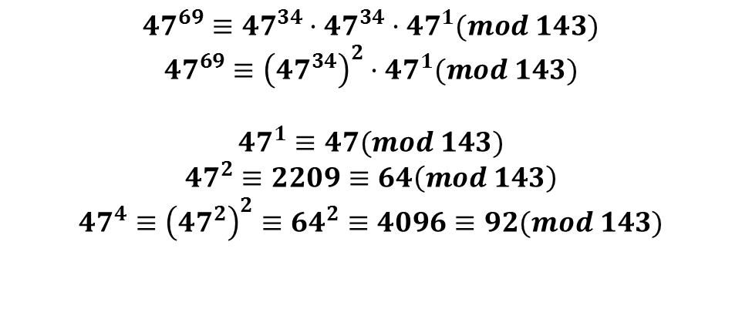
Square-and-multiply is O(log(modulus))
$${47}^{69}≡{47}^{34}·{47}^{34}·{47}^{1}(mod 143)$$
$${47}^{69}≡{\left({47}^{34}\right)}^{2}·{47}^{1}(mod 143)$$
$${47}^{1}≡47(mod 143)$$
$${47}^{2}≡2209≡64\left(mod 143\right)$$
$${47}^{4}≡{\left({47}^{2}\right)}^{2}≡{64}^{2}≡4096≡92(mod 143)$$
INSERT
VIDEO
HERE

Slide 28
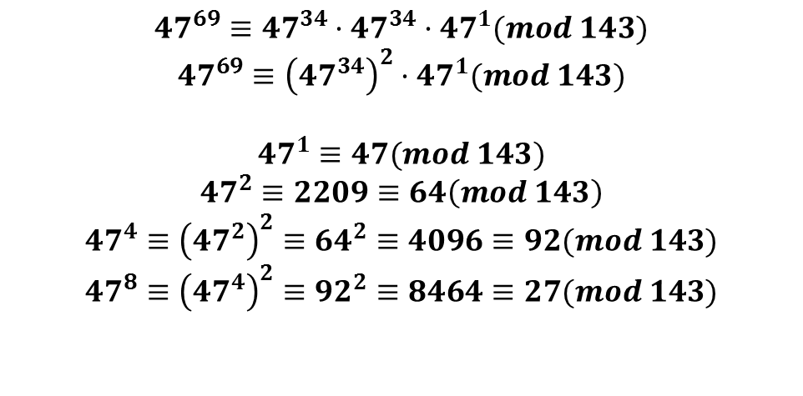
Square-and-multiply is O(log(modulus))
$${47}^{69}≡{47}^{34}·{47}^{34}·{47}^{1}(mod 143)$$
$${47}^{69}≡{\left({47}^{34}\right)}^{2}·{47}^{1}(mod 143)$$
$${47}^{1}≡47(mod 143)$$
$${47}^{2}≡2209≡64\left(mod 143\right)$$
$${47}^{4}≡{\left({47}^{2}\right)}^{2}≡{64}^{2}≡4096≡92(mod 143)$$
$${47}^{8}≡{\left({47}^{4}\right)}^{2}≡{92}^{2}≡8464≡27(mod 143)$$
INSERT
VIDEO
HERE

Slide 29
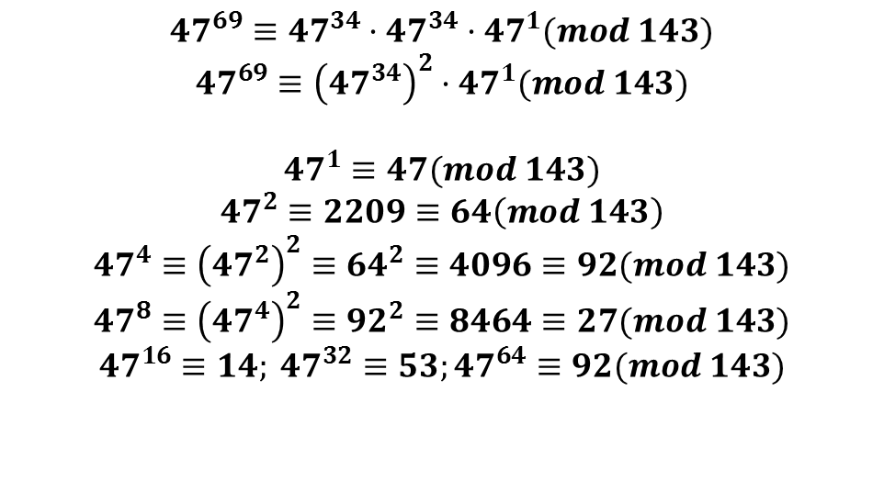
Square-and-multiply is O(log(modulus))
$${47}^{69}≡{47}^{34}·{47}^{34}·{47}^{1}(mod 143)$$
$${47}^{69}≡{\left({47}^{34}\right)}^{2}·{47}^{1}(mod 143)$$
$${47}^{1}≡47(mod 143)$$
$${47}^{2}≡2209≡64\left(mod 143\right)$$
$${47}^{4}≡{\left({47}^{2}\right)}^{2}≡{64}^{2}≡4096≡92(mod 143)$$
$${47}^{8}≡{\left({47}^{4}\right)}^{2}≡{92}^{2}≡8464≡27(mod 143)$$
$${47}^{16}≡14; {47}^{32}≡53;{47}^{64}≡92(mod 143)$$
INSERT
VIDEO
HERE

Slide 30
Square-and-multiply uses the binary representation of the exponent
INSERT
VIDEO
HERE

Slide 31

Square-and-multiply uses the binary representation of the exponent
$${47}^{69}={47}^{64}·{47}^{4}·{47}^{1}$$
INSERT
VIDEO
HERE

Slide 32
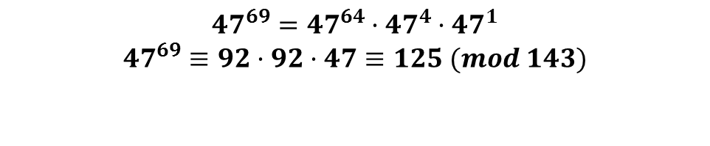
Square-and-multiply uses the binary representation of the exponent
$${47}^{69}={47}^{64}·{47}^{4}·{47}^{1}$$
$${47}^{69}≡92·92·47≡125 (mod 143)$$
INSERT
VIDEO
HERE

Slide 33
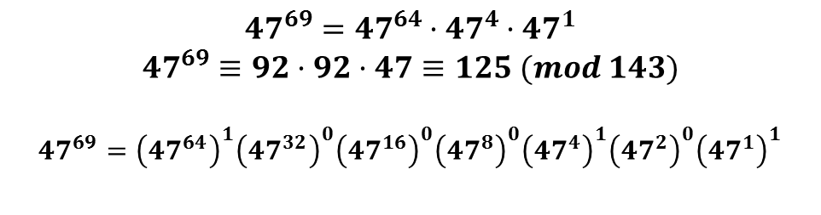
Square-and-multiply uses the binary representation of the exponent
$${47}^{69}={47}^{64}·{47}^{4}·{47}^{1}$$
$${47}^{69}≡92·92·47≡125 (mod 143)$$
$${47}^{69}={\left({47}^{64}\right)}^{1}{\left({47}^{32}\right)}^{0}{\left({47}^{16}\right)}^{0}{\left({47}^{8}\right)}^{0}{\left({47}^{4}\right)}^{1}{\left({47}^{2}\right)}^{0}{\left({47}^{1}\right)}^{1}$$
INSERT
VIDEO
HERE

Slide 34
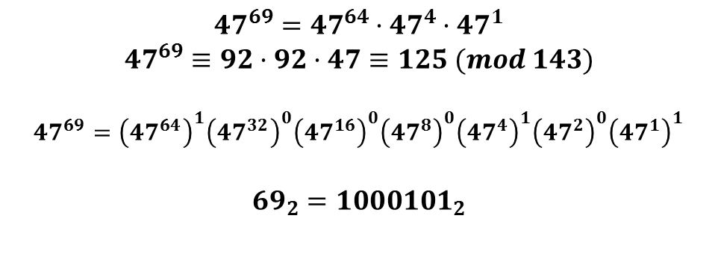
Square-and-multiply uses the binary representation of the exponent
$${47}^{69}={47}^{64}·{47}^{4}·{47}^{1}$$
$${47}^{69}≡92·92·47≡125 (mod 143)$$
$${47}^{69}={\left({47}^{64}\right)}^{1}{\left({47}^{32}\right)}^{0}{\left({47}^{16}\right)}^{0}{\left({47}^{8}\right)}^{0}{\left({47}^{4}\right)}^{1}{\left({47}^{2}\right)}^{0}{\left({47}^{1}\right)}^{1}$$
$${69}_{2}={1000101}_{2}$$
INSERT
VIDEO
HERE

Slide 35
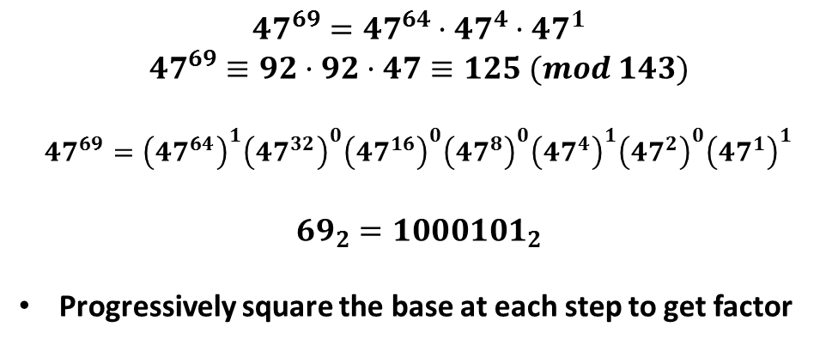
Square-and-multiply uses the binary representation of the exponent
$${47}^{69}={47}^{64}·{47}^{4}·{47}^{1}$$
$${47}^{69}≡92·92·47≡125 (mod 143)$$
$${47}^{69}={\left({47}^{64}\right)}^{1}{\left({47}^{32}\right)}^{0}{\left({47}^{16}\right)}^{0}{\left({47}^{8}\right)}^{0}{\left({47}^{4}\right)}^{1}{\left({47}^{2}\right)}^{0}{\left({47}^{1}\right)}^{1}$$
$${69}_{2}={1000101}_{2}$$
Progressively square the base at each step to get factor
INSERT
VIDEO
HERE

Slide 36
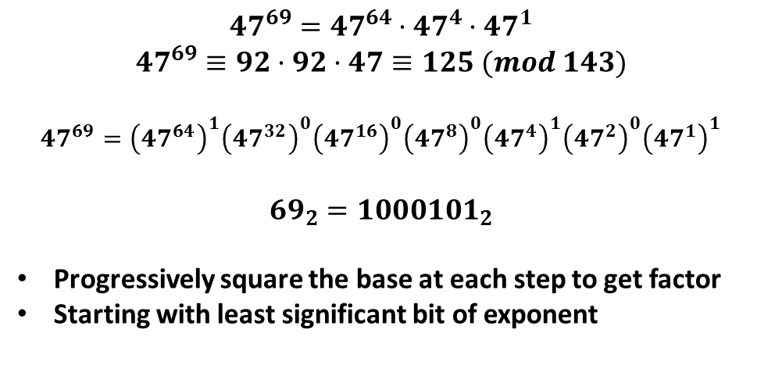
Square-and-multiply uses the binary representation of the exponent
$${47}^{69}={47}^{64}·{47}^{4}·{47}^{1}$$
$${47}^{69}≡92·92·47≡125 (mod 143)$$
$${47}^{69}={\left({47}^{64}\right)}^{1}{\left({47}^{32}\right)}^{0}{\left({47}^{16}\right)}^{0}{\left({47}^{8}\right)}^{0}{\left({47}^{4}\right)}^{1}{\left({47}^{2}\right)}^{0}{\left({47}^{1}\right)}^{1}$$
$${69}_{2}={1000101}_{2}$$
Progressively square the base at each step to get factor
Starting with least significant bit of exponent
INSERT
VIDEO
HERE

Slide 37
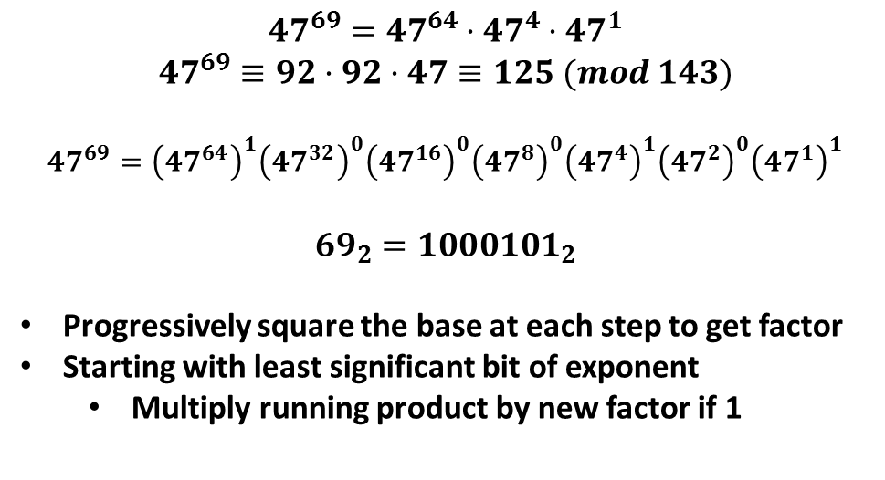
Square-and-multiply uses the binary representation of the exponent
$${47}^{69}={47}^{64}·{47}^{4}·{47}^{1}$$
$${47}^{69}≡92·92·47≡125 (mod 143)$$
$${47}^{69}={\left({47}^{64}\right)}^{1}{\left({47}^{32}\right)}^{0}{\left({47}^{16}\right)}^{0}{\left({47}^{8}\right)}^{0}{\left({47}^{4}\right)}^{1}{\left({47}^{2}\right)}^{0}{\left({47}^{1}\right)}^{1}$$
$${69}_{2}={1000101}_{2}$$
Progressively square the base at each step to get factor
Starting with least significant bit of exponent
Multiply running product by new factor if 1
INSERT
VIDEO
HERE

Slide 38
In review…
INSERT
VIDEO
HERE

Slide 39
In review…
Brute force modular exponentiation too expensive
INSERT
VIDEO
HERE

Slide 40
In review…
Brute force modular exponentiation too expensive
Reduce base mod-N, exponent mod(ϕ(N))
INSERT
VIDEO
HERE

Slide 41
In review…
Brute force modular exponentiation too expensive
Reduce base mod-N, exponent mod(ϕ(N))
Multiply-and-reduce keeps values < N² but is O(N)
INSERT
VIDEO
HERE

Slide 42
In review…
Brute force modular exponentiation too expensive
Reduce base mod-N, exponent mod(ϕ(N))
Multiply-and-reduce keeps values < N² but is O(N)
Square-and-multiply O(log(N)) – very efficient
INSERT
VIDEO
HERE

Slide 43
In review…
Brute force modular exponentiation too expensive
Reduce base mod-N, exponent mod(ϕ(N))
Multiply-and-reduce keeps values < N² but is O(N)
Square-and-multiply O(log(N)) – very efficient
Coming up: Euler’s Totient Function
INSERT
VIDEO
HERE

